Slide 1
Joint Action Best-ReMaP
Official presentation
Name, institution and WP of presenter
DD.MM.YYYY

Slide 2
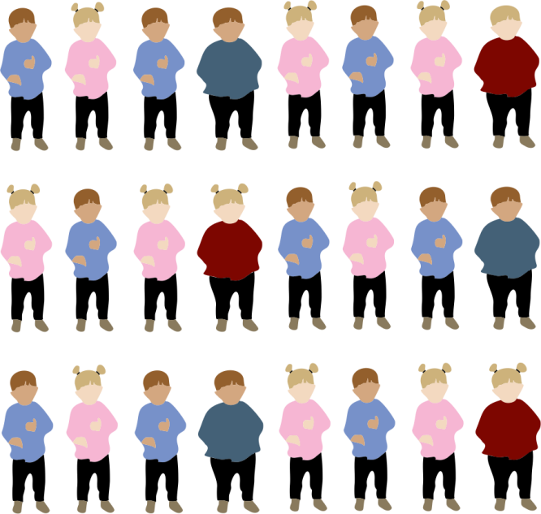
Introduction
THE CONTEXT
Nearly 1 in 4 children in Europe are overweight or obese. One of the reasons for this is having an unhealthy diet.
In the first years of life food preferences are also forming. Most are learned, but some are intuitive. A child’s food preferences directly affect eating behaviour, which then has a direct effect on overall health, wellness and the risk of obesity.
As children get older, they are exposed to unhealthy foods, which is mainly caused by inappropriate advertising and the easy availability of processed and ultra processed foods high in salt, sugar and fat either at home or in public institutions where they spend a considerable amount of time.

Slide 3
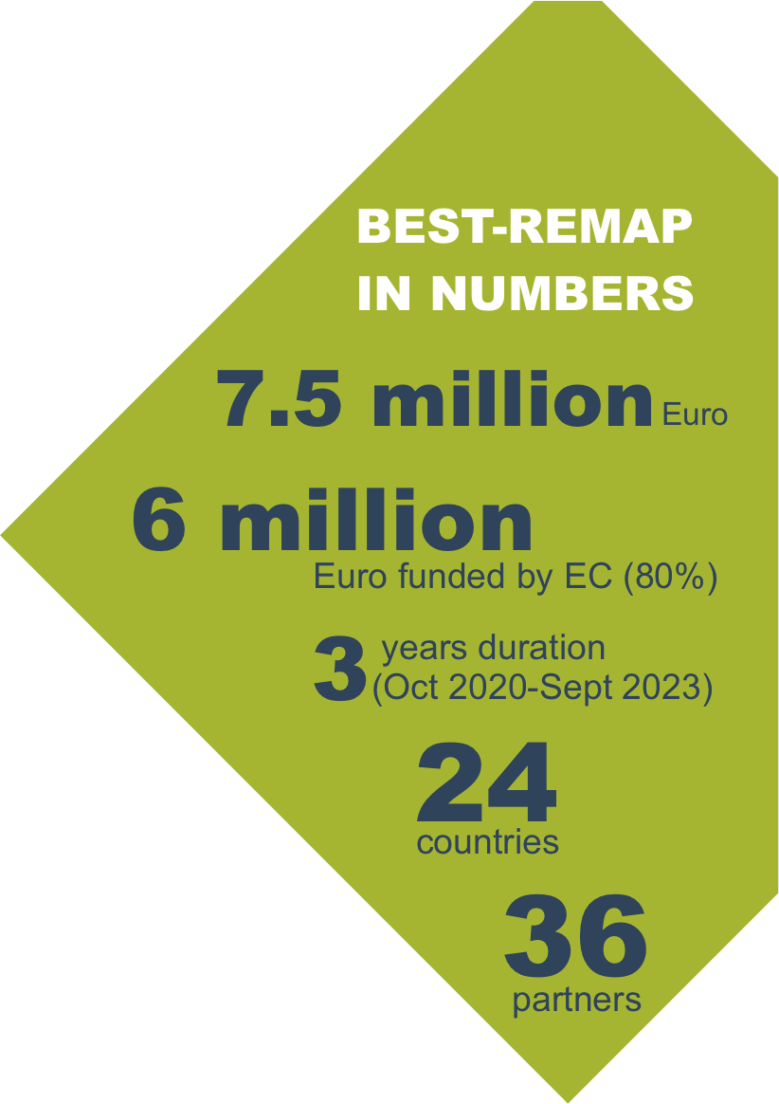
KEY FACTS
Coordination | Work Package 1
National Institute of Public Health Slovenia (NIJZ)
Dissemination | Work Package 2
Semmelweis University, Hungary
Evaluation | Work Package 3
The Finnish Institute for Health and Welfare, Finland
Sustainability and Integration into National Policies
| Work Package 4
Istituto Superiore di Sanità, Italy
EU Harmonised reformulation and processed food monitoring
| Work Package 5
French Agency for Food, Environmental and Occupational
Health & Safety – ANSES, France)
Best practices in reducing marketing of unhealthy food products
to children and adolescents | Work Package 6
Directorate­ General of Health of Portugal and Irish Department of Health, Portugal, Ireland
Public procurement of food in public institutions | Work Package 7
National Institute of Public Health Slovenia – NIJZ, Slovenia

Slide 4
OTHER PROJECTS BEST-REMAP BUILDS ON
JANPA Joint Action on Nutrition and Physical Activity
EUREMO Study on EU Reformulation Monitoring
STOP Project on Science and Technology in Childhood Obesity Policy
CO-CREATE Project

Slide 5
TARGETED PROBLEMS
1
2
Only a few countries in Europe are able to monitor processed food supply at the brand level.
Food advertising and marketing to children is currently unregulated in Europe.
3
The lack of high-quality food in public institutions like kindergartens, schools and hospitals.

Slide 6
WHAT WE WANT TO ACHIEVE
Change the food environment for children in Europe.
Reduce the impact of harmful marketing of foods to children.
Improve the quality of menus in public institutions.
Build stakeholder networks in the field of nutrition at national and EU levels.
Create a Food Information Database with working title “JRC food database”
- a tool for Member States to regularly report and explore national data that is also made available to researchers and public policy advisors.

Slide 7
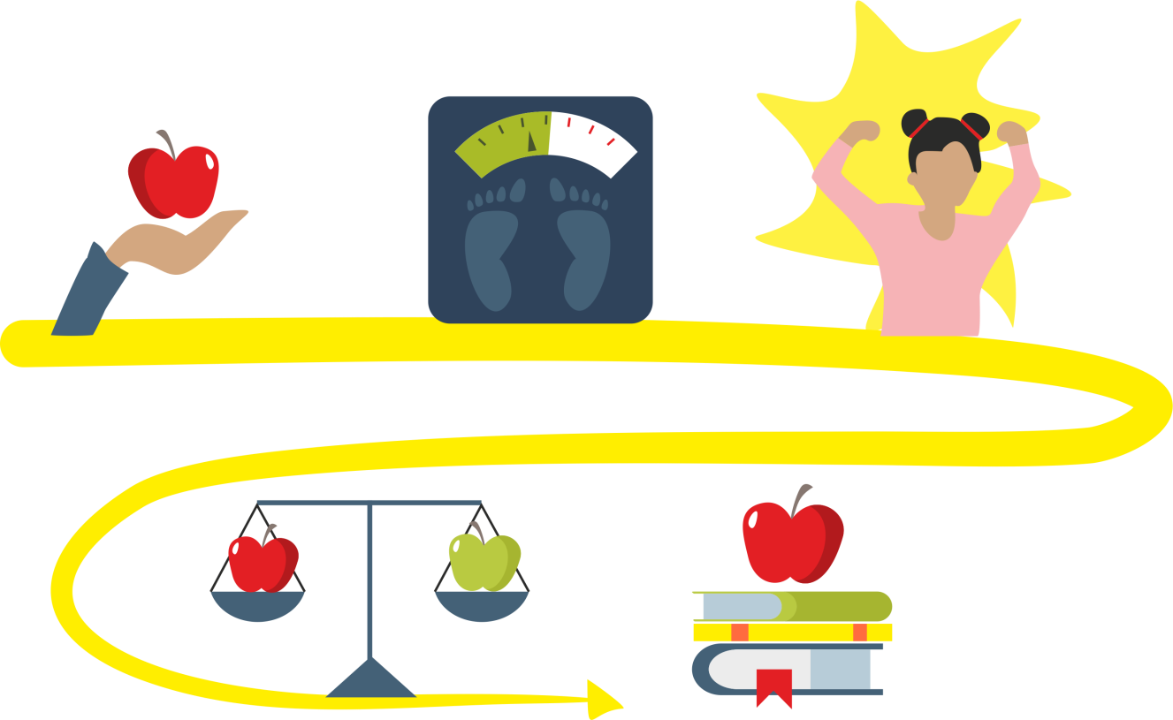
OUR APPROACH
Share and promote best practices on how to implement a standardized European monitoring system for processed food reformulation.
Identify best policy practices to reduce exposure of children to the marketing of unhealthy foods and develop harmonized protocols to monitor marketing exposure of children.
Contribute to the higher quality of menus, by ensuring transparent quality of the prepared foods in the selected public institutions.

Slide 8
OUR STAKEHOLDERS AND MAIN TARGET GROUPS
Primary target group
policy decision makers of national and regional governments
Secondary target group
food producers and the retail sector
parent and youth organisations
Tertiary target group
civil society, academia and professional organisations
general public and individuals (e.g. parents, grandparents, children, adolescents)
Children and adolescents are the indirect end users of the policy measure outcomes produced by
Best-ReMaP.

Slide 9
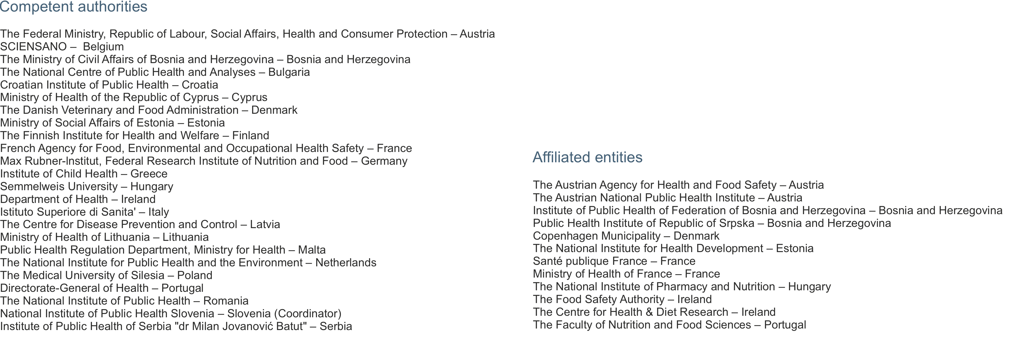
THE CONSORTIUM

Slide 10
Contact information
Coordination
National Institute of Public Health Slovenia
best.remap@nijz.si
Communications
Semmelweis University Hungary
bestremap@emk.semmelweis.hu
Official website
https://bestremap.eu/
Official Facebook page
https://www.facebook.com/Best-Remap-EU-103045795026362/

Slide 11
Thank you
for your attention!
The Joint Action focusing on the implementation of
validated best practices in nutrition – Best-ReMaP
This presentation arises from the Joint Action Best-ReMaP. This JA is addressing the adaption, replication and implementation of effective health interventions, based on practices that have been proven to work in the areas of food reformulation, framing of food marketing and public procurement of healthy food in public settings. This presentation was funded by the European Union’s Health Programme (2014-2020). The content of this presentation represents the views of the author only and is his/her sole responsibility; it cannot be considered to reflect the views of the European Commission and/or the Consumers, Health, Agriculture and Food Executive Agency (CHAFEA) or any other body of the European Union. The European Commission and the Agency do not accept any responsibility for use that may be made of the information it contains.

